Slide 1

Brainsuite

Slide 2
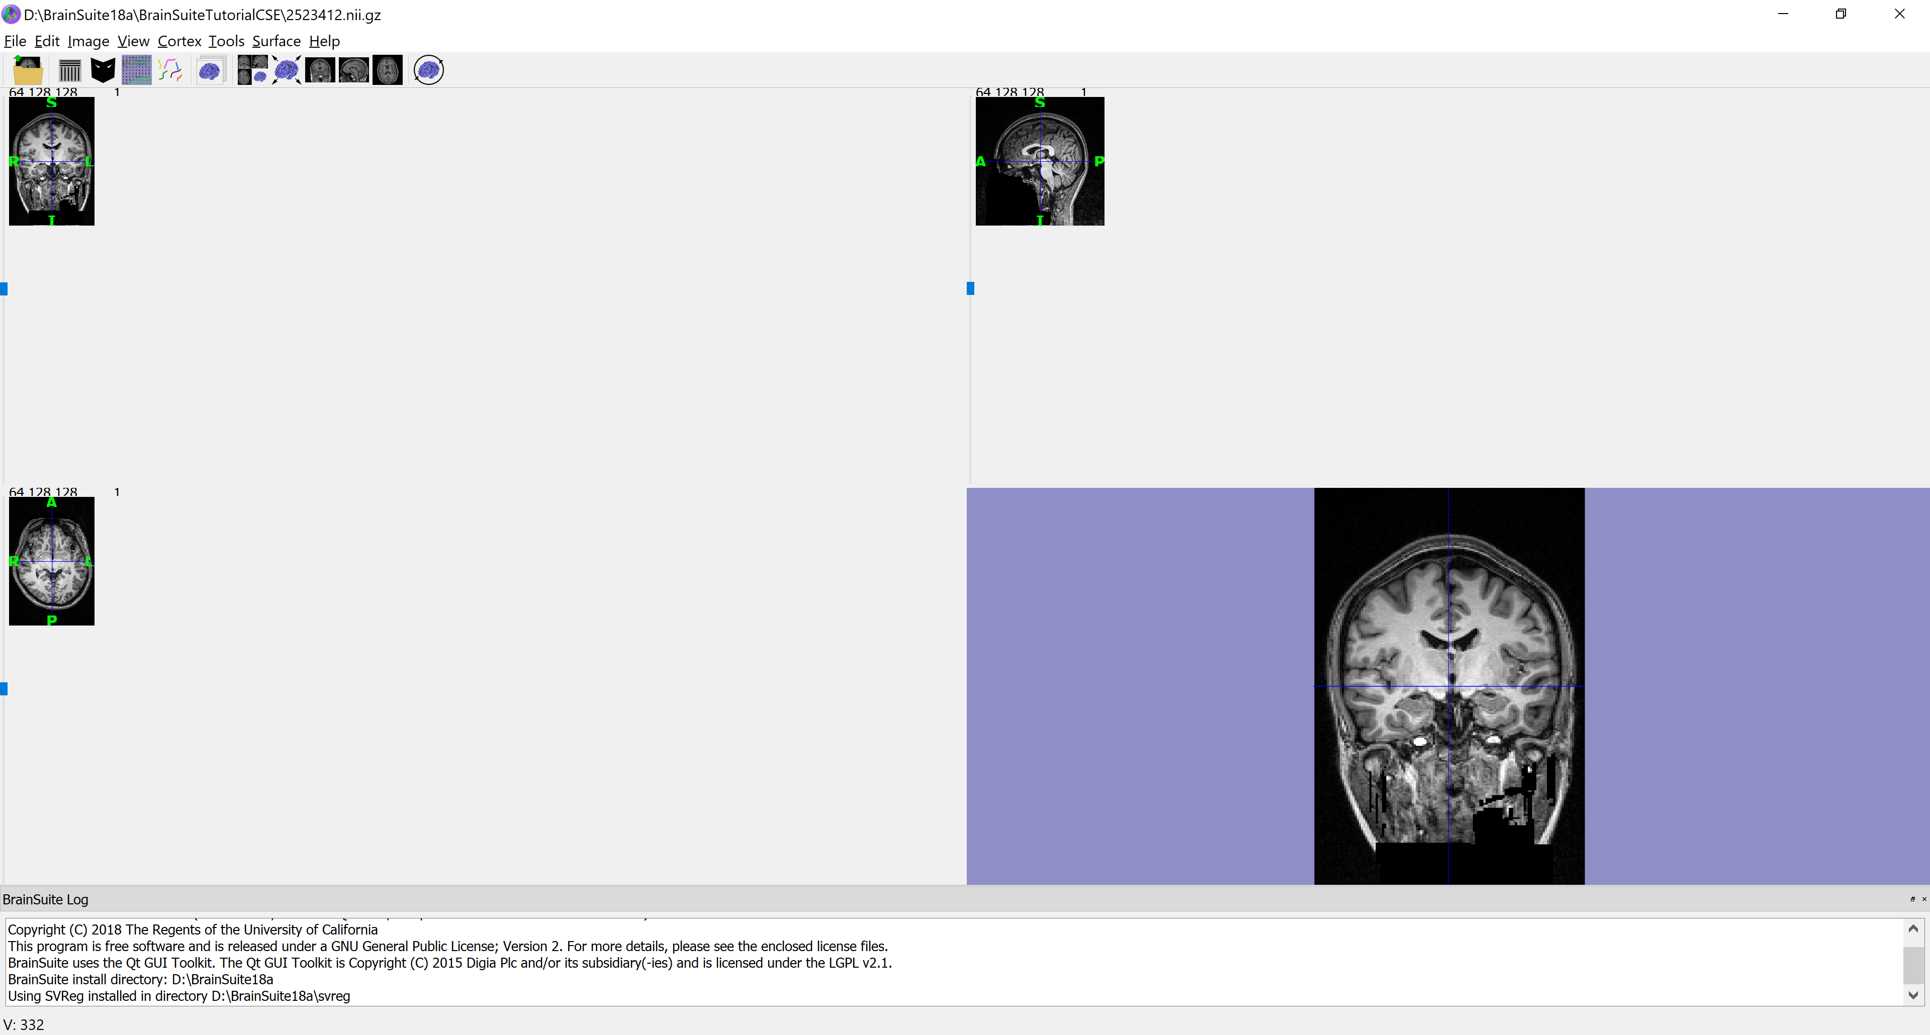
Data

Slide 3
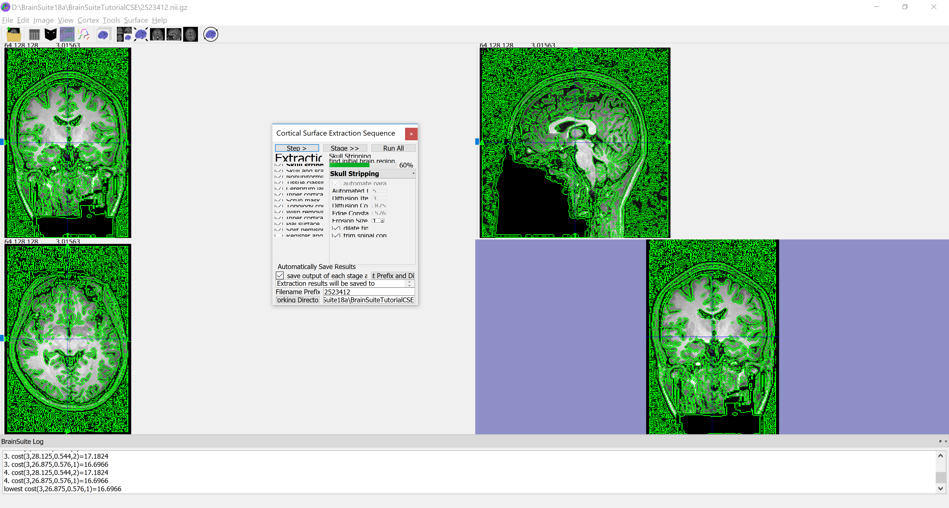
BSE steps

Slide 4
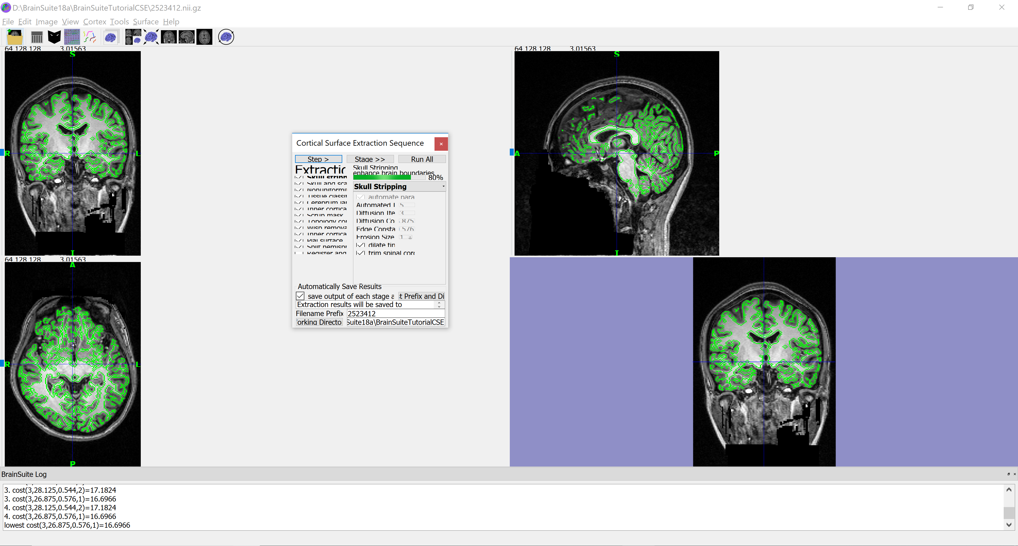
BSE

Slide 5
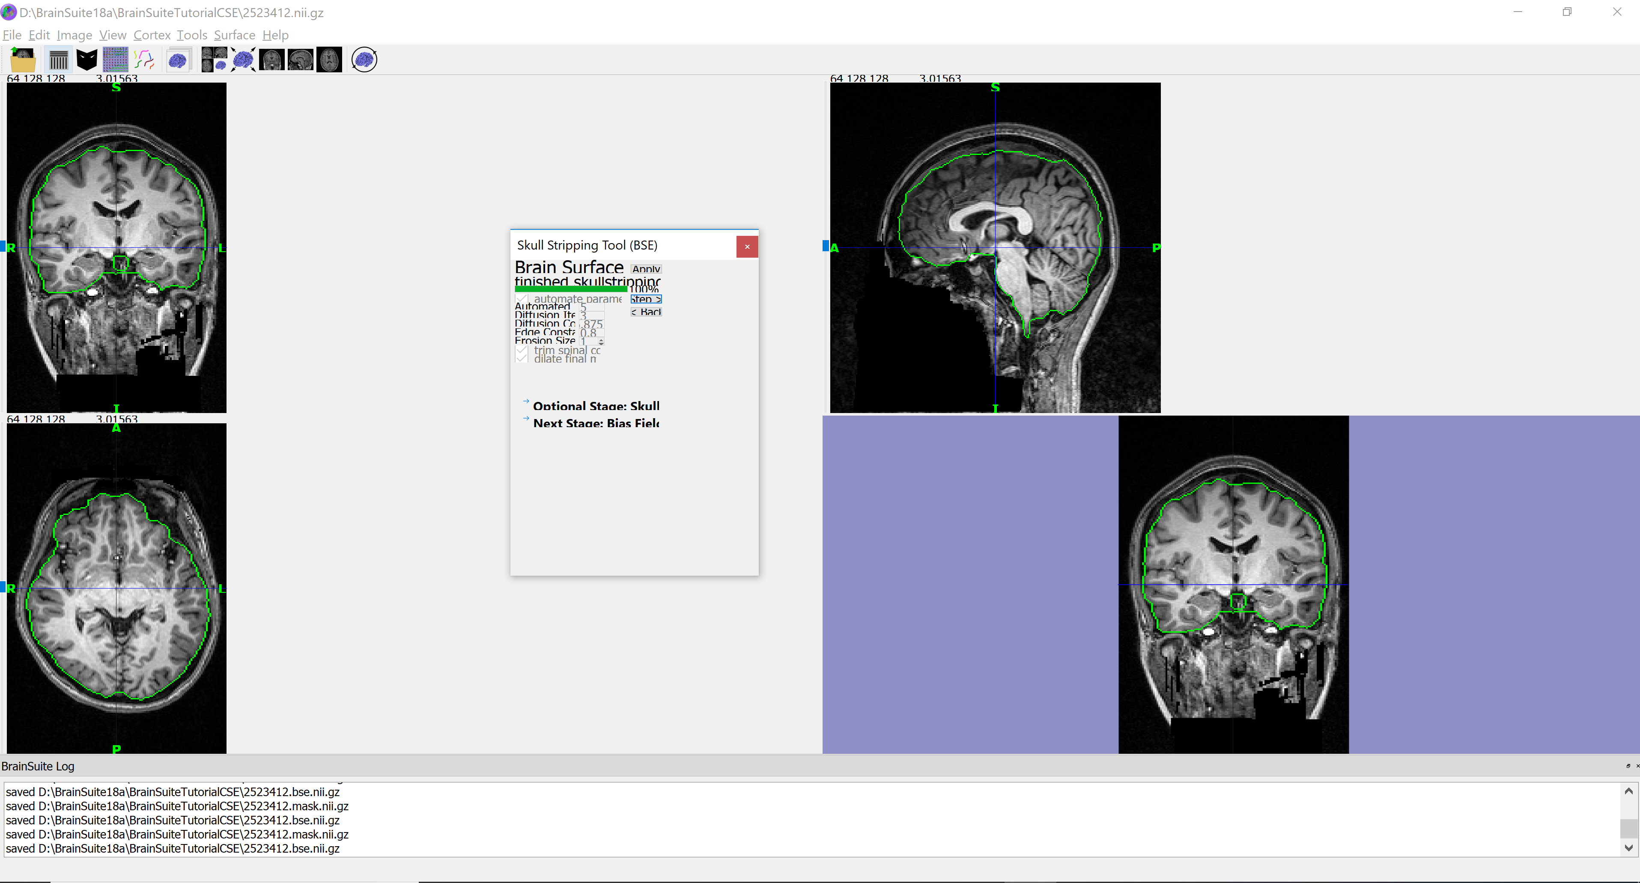
BSE with edge constant = 0.8

Slide 6
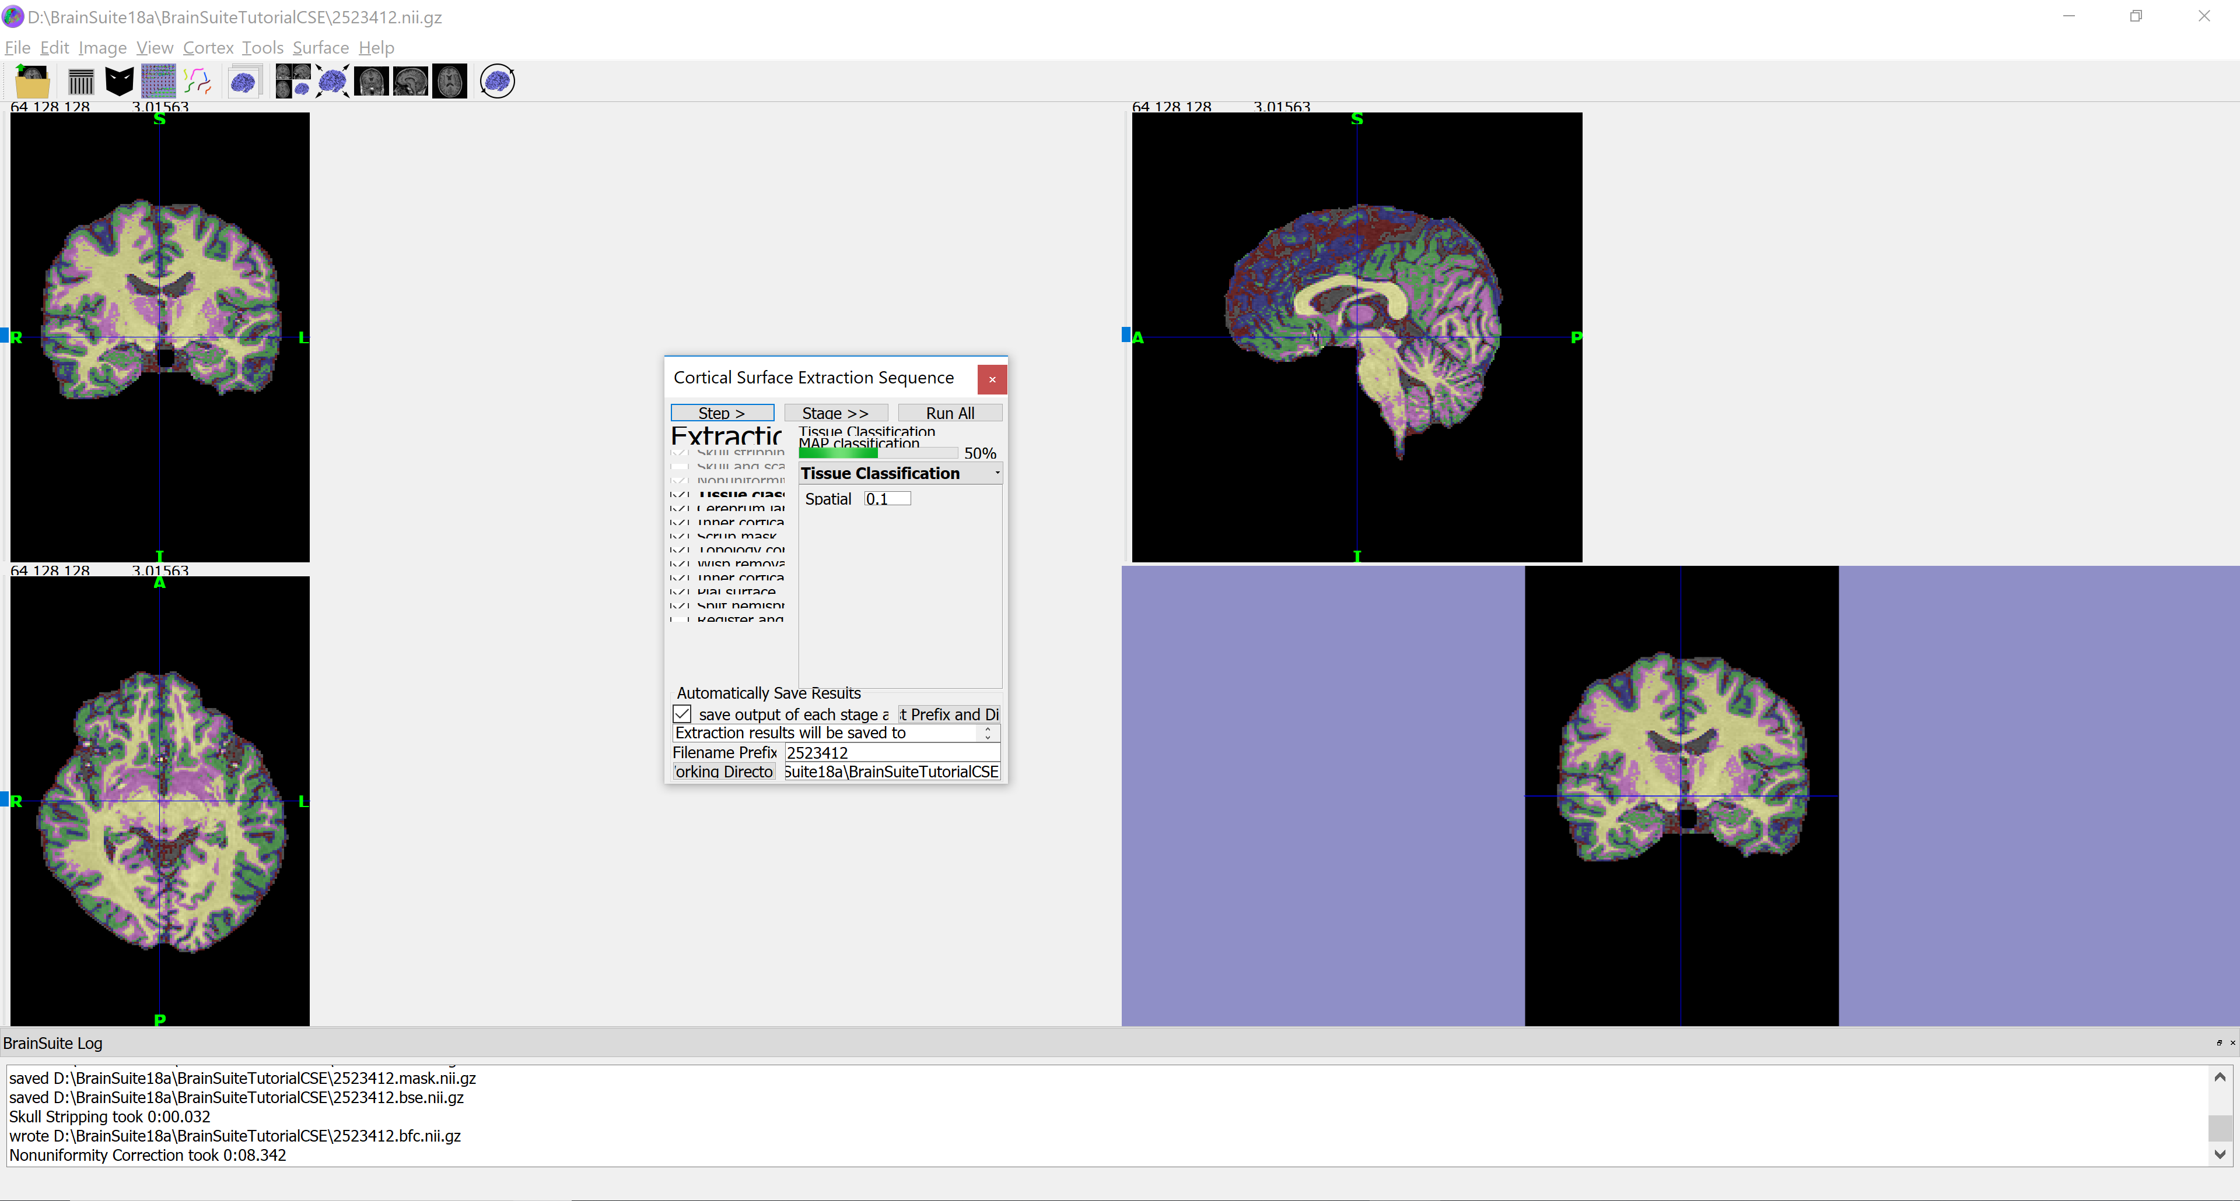
Skull stripping – Non Uniformity correction

Slide 7
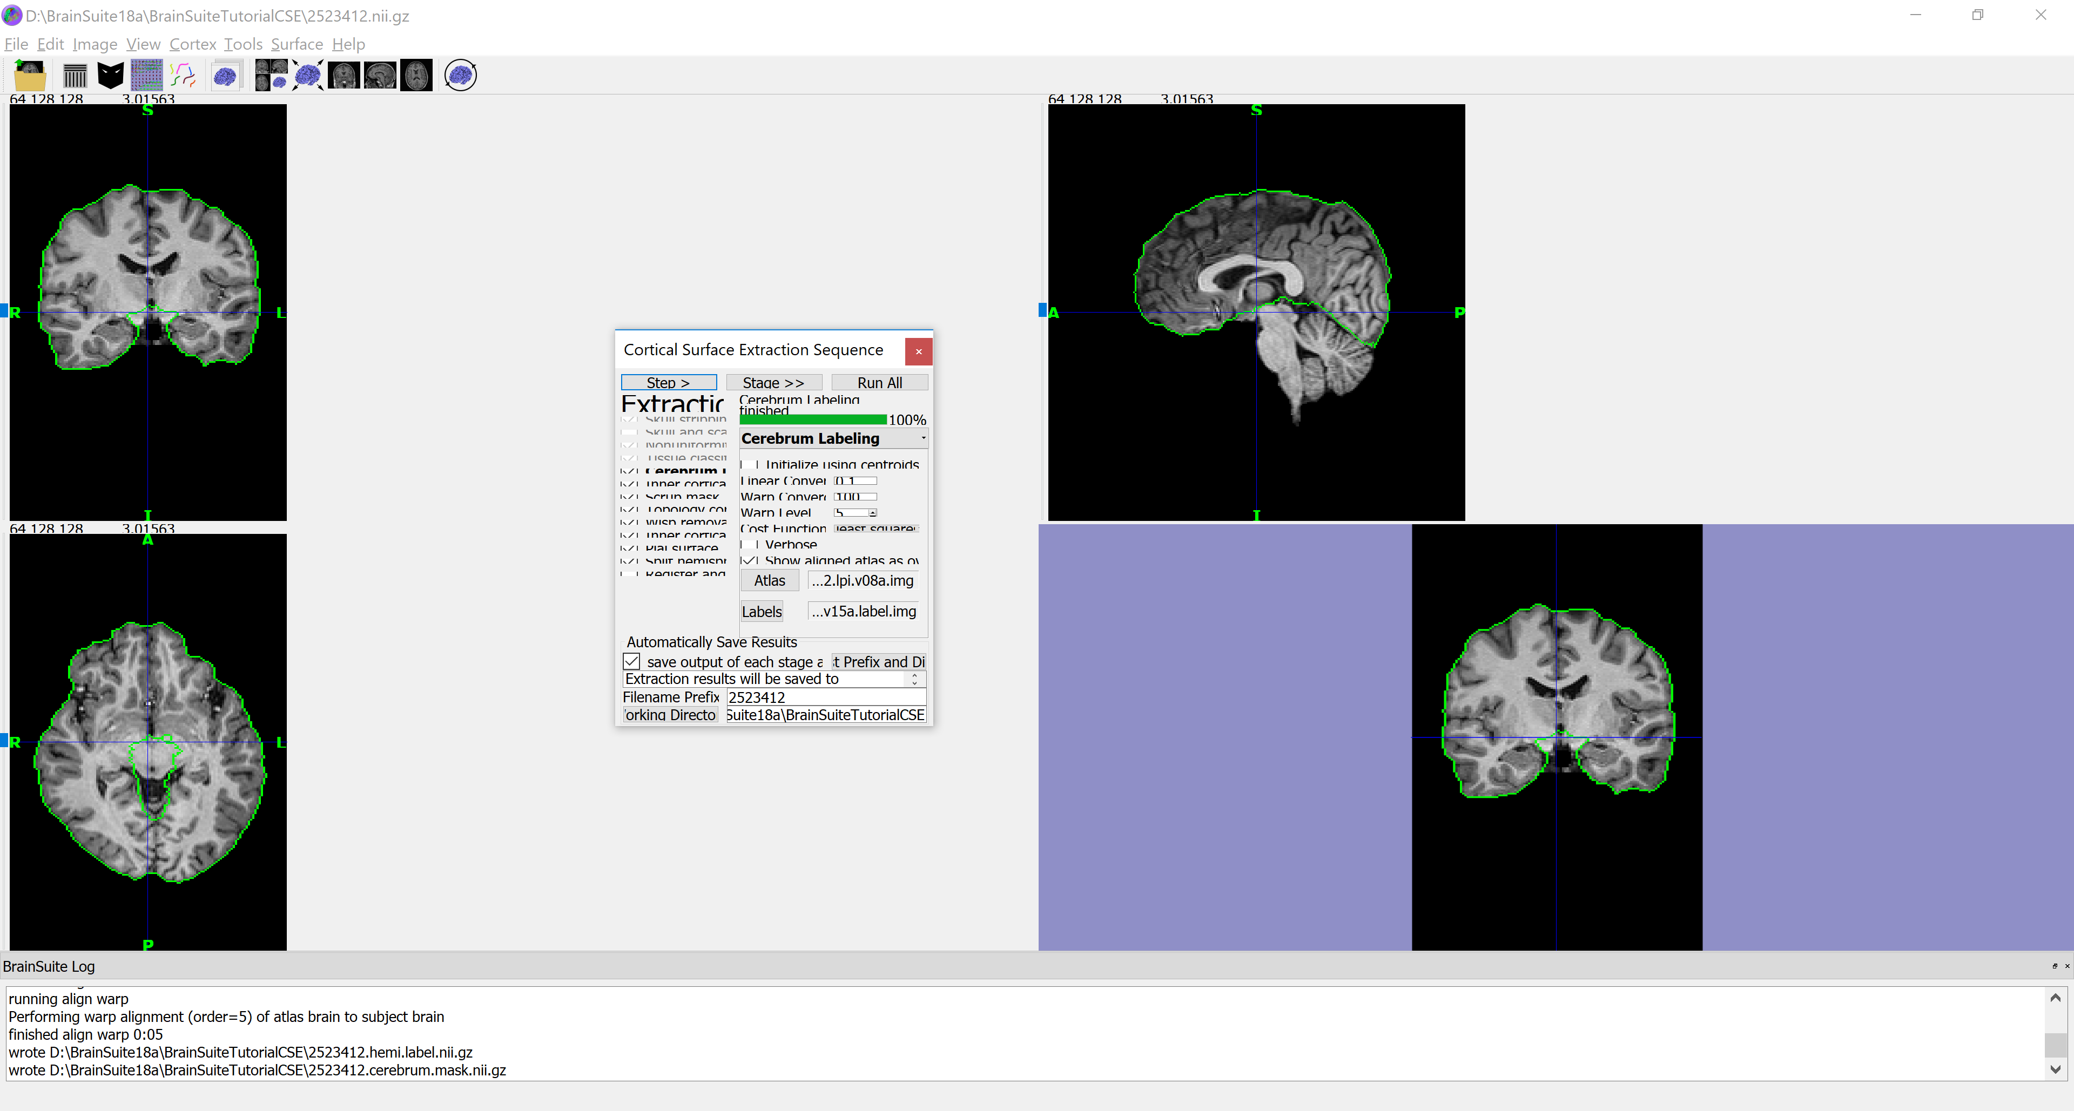
Cerebrum Labelling

Slide 8
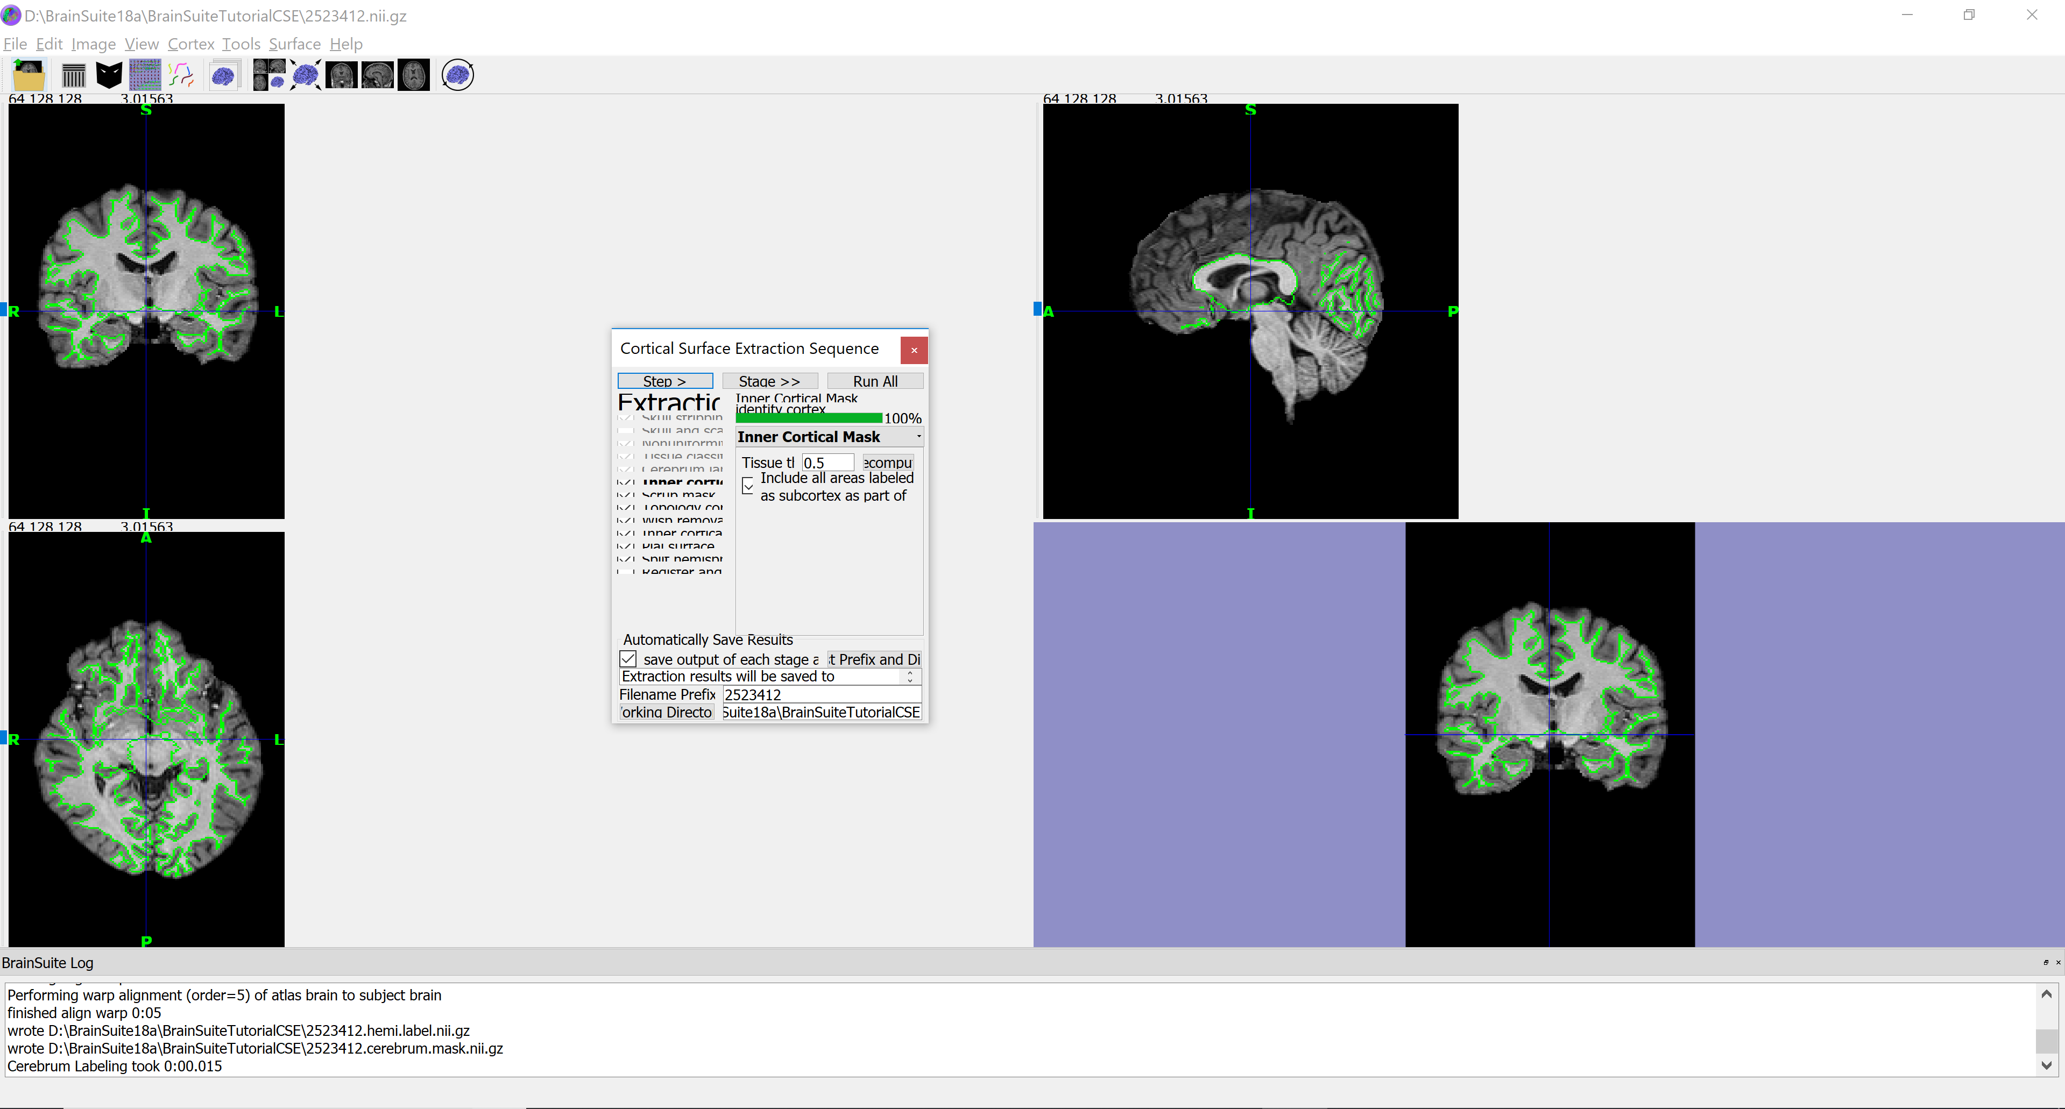
Inner Cortical Mask

Slide 9

Scrubbing Mask

Slide 10

Topology Correction

Slide 11

Wisp Removal

Slide 12

Inner Cortical Surface

Slide 13
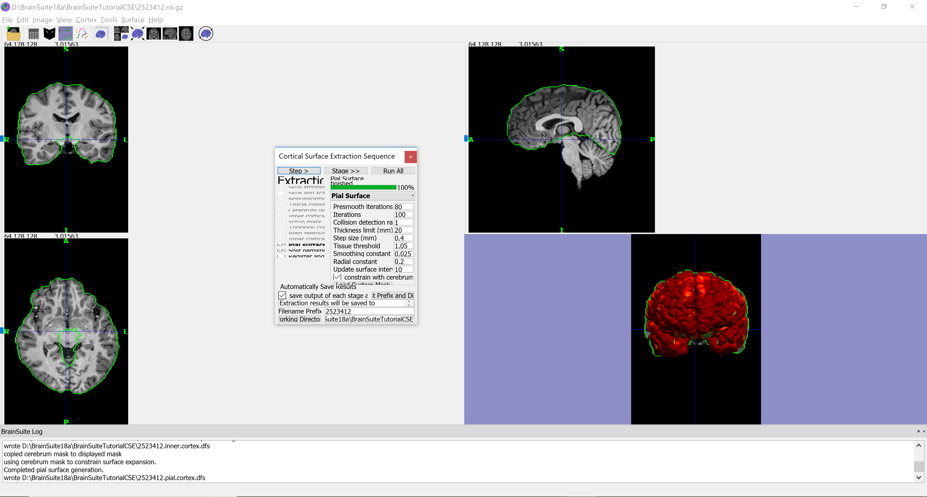
Pial Surface Expansion

Slide 14
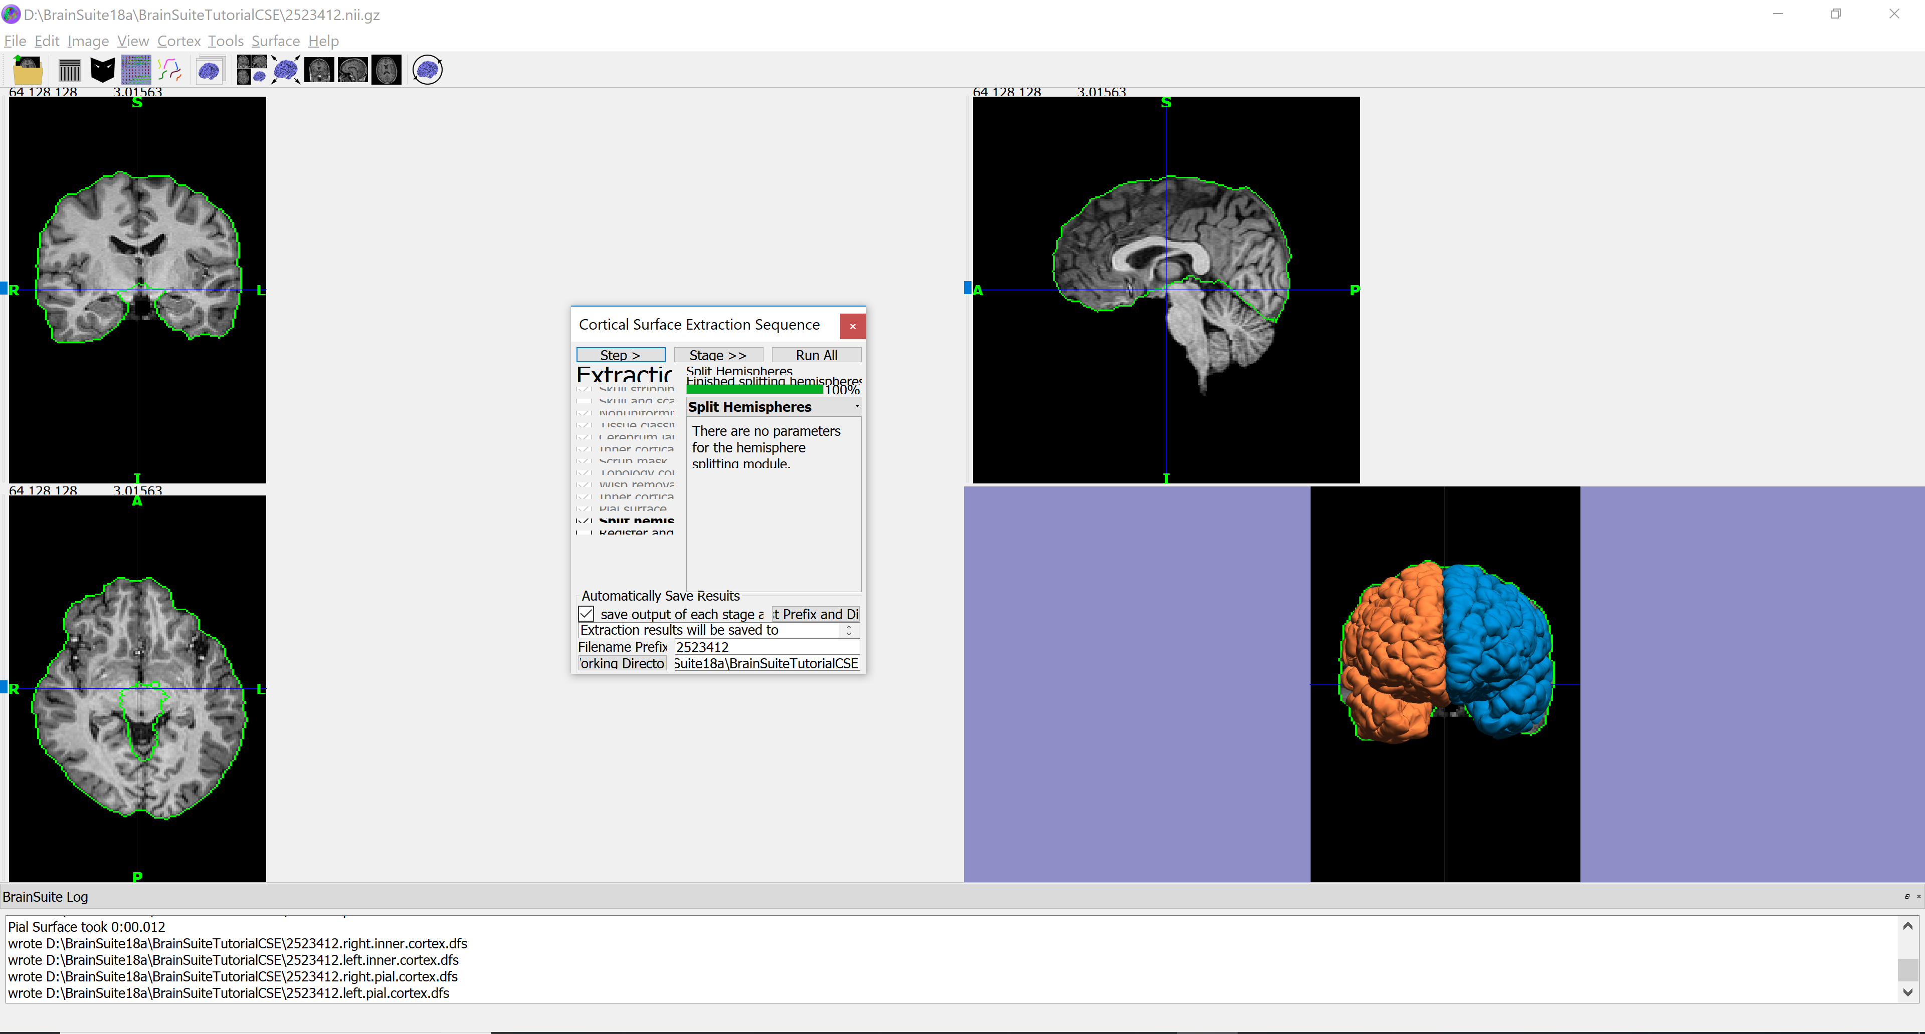
Split Hemispheres

